Slide 1
Is poverty moving to the suburbs in Scottish Cities?
Jon Minton & Nick Bailey

Slide 2
Presentation Structure
Background
Method
Results
Discussion
Further work

Slide 3
Background
Stereotype (perhaps a US import) that ‘poverty is an urban issue’
‘Inner city’ as synonym for poor and crime ridden
Selective migration of middle class to the suburbs (‘White Flight’ in US)
Abandonment of the city by all who can – ‘doughnut cities’
Urban Revival
Back to the city movements
Gentrification
Generational shifts in driving
Sustainability and amenities

Slide 4
Background
Congestion
effects
Agglomeration
effects
Low
Centrality (/Density)
High

Slide 5
Background
Congestion
effects
Agglomeration
effects
Low
Centrality (/Density)
High

Slide 6
Background
Congestion
effects
Agglomeration
effects
Low
Centrality (/Density)
High

Slide 7
Background
Congestion
effects
Agglomeration
effects
Low
Centrality (/Density)
High

Slide 8
Background
Congestion
effects
Agglomeration
effects
Low
Centrality (/Density)
High

Slide 9
Background
In thinking about the above, consider the importance of
Price: both housing and affordability
Tenure: ‘stickiness’ of social housing; ‘slippiness’ of private rented
Supply of above
The influence of history: path dependency
Evolving preferences and opportunities:
ICT and opportunity costs of car travel
Spatial distribution of labour market
Etc etc

Slide 10
Background
Kavanagh, Lee & Pryce 2016 (KLP) article:
“Is poverty decentralising? Quantifying uncertainty in the decentralisation of urban poverty” (doi: 10.1080/24694452.2016.1213156)
Used the relative centralisation index (RCI) to explore change in poverty in four Scottish cities between 2001 and 2011
Limits -1 to 1: describes relative spatial distribution of group A cf group B wrt a central point. 0 means centralisation patterns no different between group A and group B
Applies a Bayesian spatial statistical model:
Formalises ‘Tobler’s Law’
Produce credible intervals (posterior distribution): allows questions about whether changes are ‘statistically significant’ to be answered more robustly
Data used:
Census, 2001 and 2011
Three types of benefit: JSA; IS; IB
Sensitivity Analyses:
Spatial extent of city regions
Position of city centre

Slide 11
KLP Findings
Statistically significant falls in decentralisation in all four cities (Aberdeen, Dundee, Edinburgh, Glasgow)
Invariant to choice of poverty measure
(largely) invariant to extent of city regions
Invariant to reasonable choices about city centre location
Edinburgh is different, but also similar
Affluence is centralised in Edinburgh, and has become more so
Poverty is centralised in other Scottish cities, and has become less so
Used similar approach to see if cities became less segregated (D) as they became less centralised:
yes in Edinburgh; maybe in Glasgow & Dundee; no in Aberdeen

Slide 12
Aims
To replicate analyses using a different poverty indicator
To extend to more Scottish cities
Vital importance of replication work
‘Replication Crisis in Psychology’
Likely even worse in other social science disciplines
Non-quantitative/non-empirical(?) leaning of much UK social science
Logico-deductive (‘axiomatic’) tendencies in economics. (Algebraically expressed theories hermetically sealed from empirical analyses.)
To explore:
spatial variation visually
Influence of numerator and denominator change

Slide 13
Our Data
Scottish Index of Multiple Deprivation (SIMD)
Datazone population counts ‘income deprived’
For years: 2004, 2006, 2009, 2012, 2016
Spatial units
2011 datazones – mapped from 2001 datazones for earlier releases
Code set to run on day of SIMD 2016 release
Draft technical report and draft article written beforehand; updated on the day; Conversation article produced and released by end of day

Slide 14
Definitions of city centres
Place | 2011 Datazone | Postcode | Description
Aberdeen | S01006646 | AB10 1AN | Shoe Lane
Glasgow | S01010265 | G1 3BU | West End of George Square
Edinburgh | S01008677 | EH1 1BQ | 31 Waverley Bridge
Dundee | S01007705 | DD1 2AJ | Commercial Street
Inverness | S01010620 | IV1 1HY | High Street/Castle Street
Perth | S01011939 | PH2 8PA | South Street
Falkirk and Stirling | S01013067 | FK8 2LJ | Port Street

Slide 15
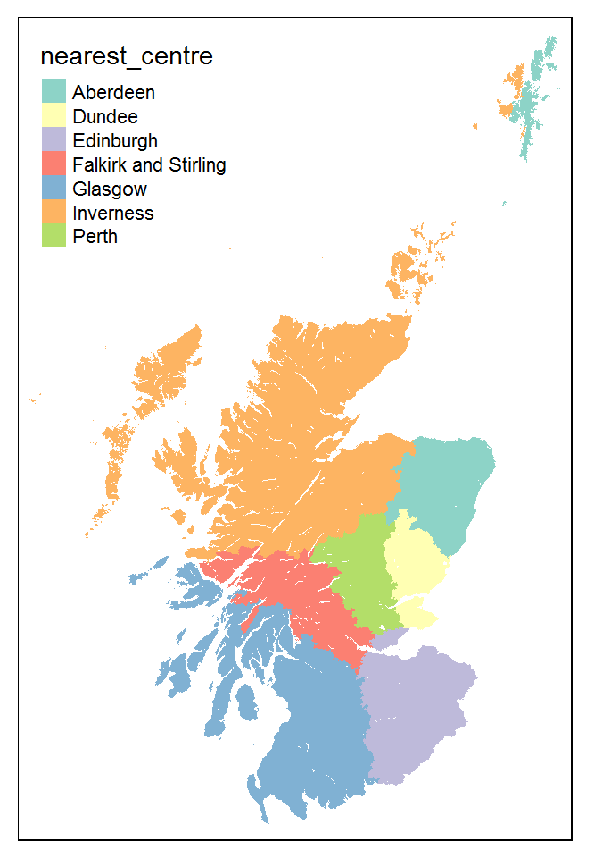
Scotland by nearest city centre
Implausible for some remote places linked to Inverness & Aberdeen
In practice maximum distances set and influence of extent explored
Approx 20 km of city centroid

Slide 16
Results - Maps
Income deprived proportions in Scotland
Income deprived proportions in main cities
Glasgow
Edinburgh
Dundee
Aberdeen

Slide 17
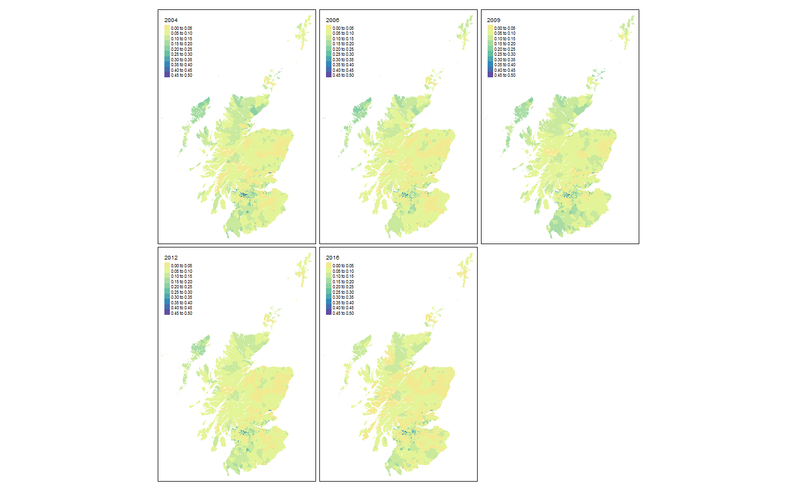

Slide 18
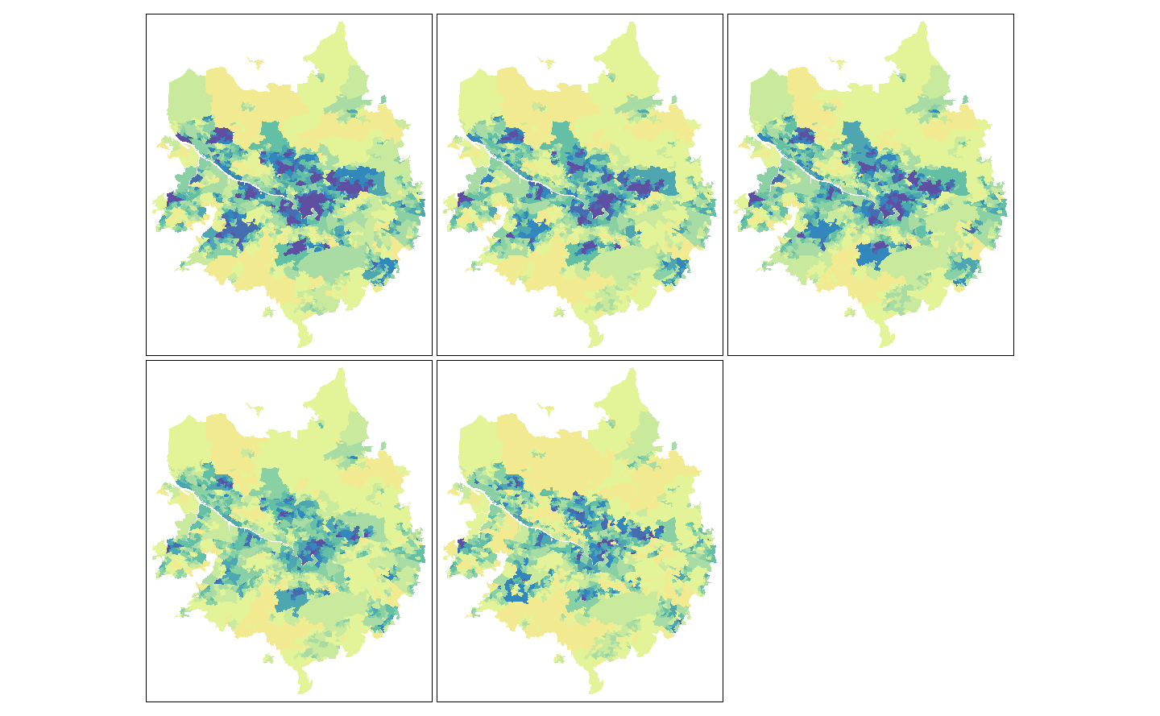

Slide 19
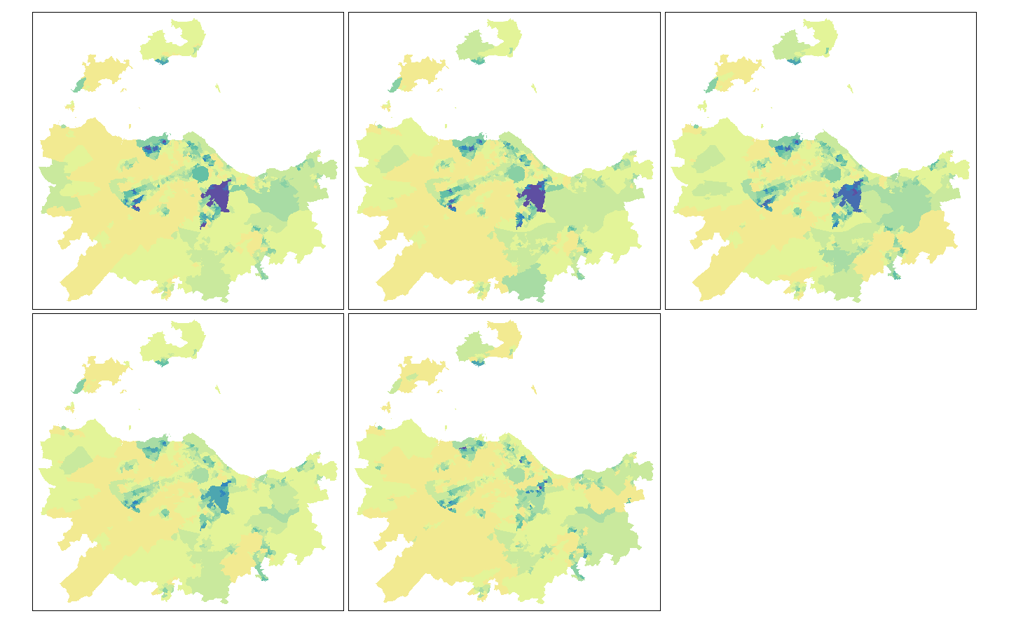

Slide 20
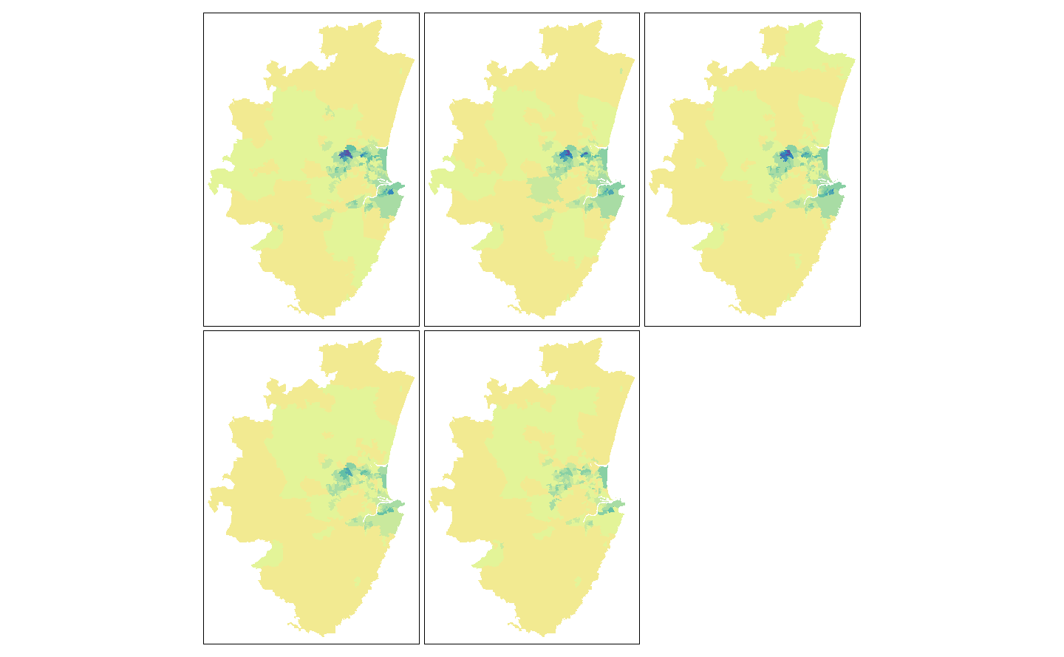

Slide 21
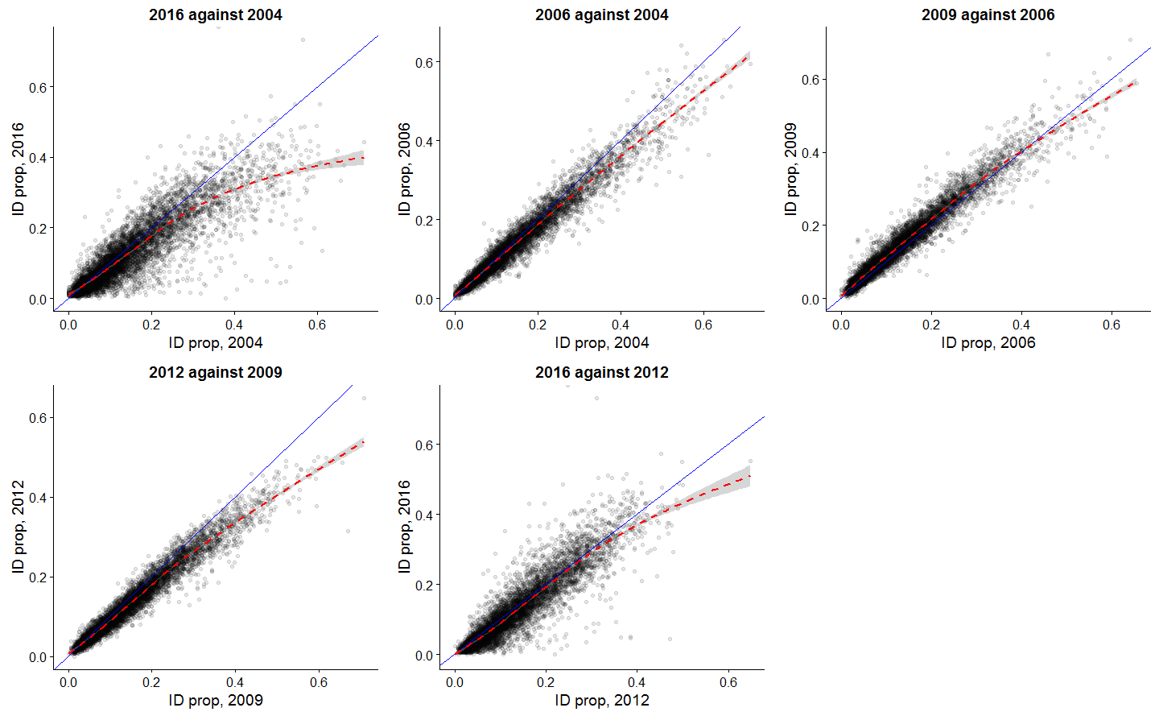
Temporal dependence in income deprivation

Slide 22
Percent income deprived by city and year
City | 2004 | 2006 | 2009 | 2012 | 2016
Aberdeen | 9.8 | 9.7 | 9.4 | 7.9 | 7.0
Perth | 10.0 | 9.9 | 10.7 | 9.7 | 9.3
Inverness | 10.7 | 9.9 | 11.0 | 9.5 | 9.0
Edinburgh | 11.9 | 11.6 | 12.3 | 10.8 | 9.7
Falkirk and Stirling | 13.7 | 12.5 | 13.3 | 12.3 | 11.7
Dundee | 16.7 | 15.4 | 16.9 | 14.5 | 13.9
Glasgow | 20.8 | 18.8 | 19.8 | 17.1 | 16.3

Slide 23
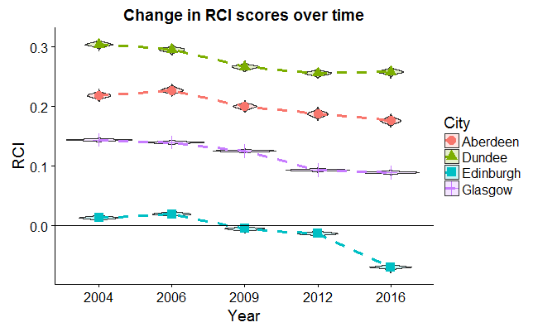
Main results: RCI with credible interval
Similar trends in all cities
Main changes between 2009 and 2012
Edinburgh is different
Accelerated centralisation of affluence

Slide 24
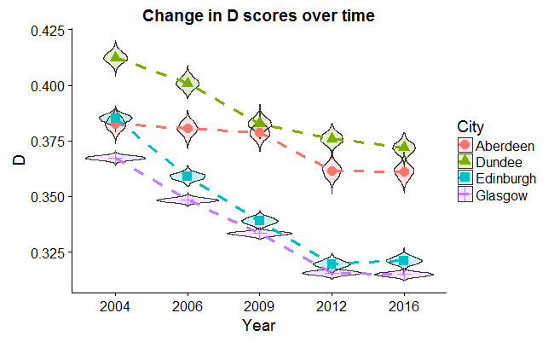
Supplementary results: D with credible interval
Fall in segregation, longer term trend
Most rapid in Edinburgh & Glasgow - convergence
Least in Aberdeen & Dundee

Slide 25
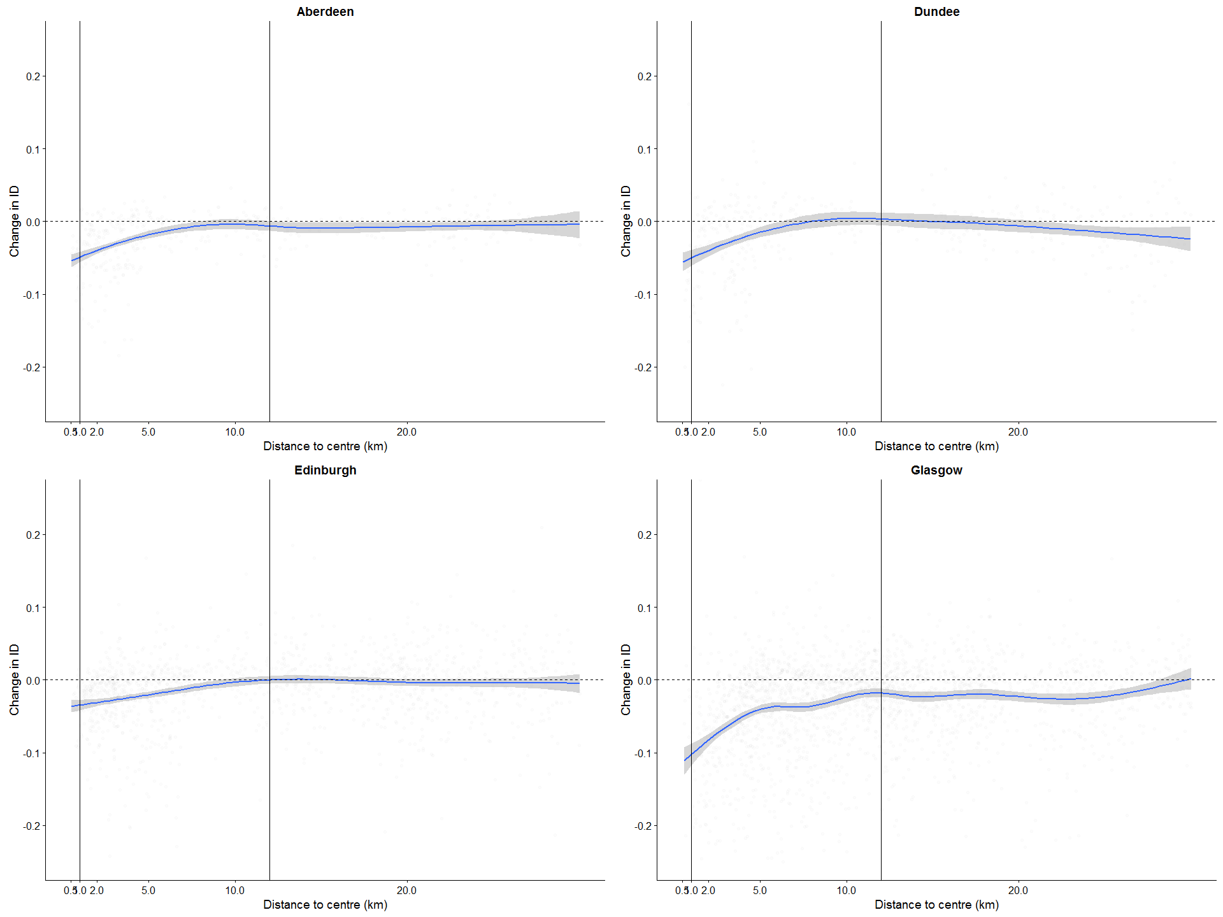
Change in income deprivation by distance
Fall in ID concentrated in first 6-10km
No change after ~ 12k for Aberdeen, Edinburgh, (Dundee)
Global fall in Glasgow

Slide 26
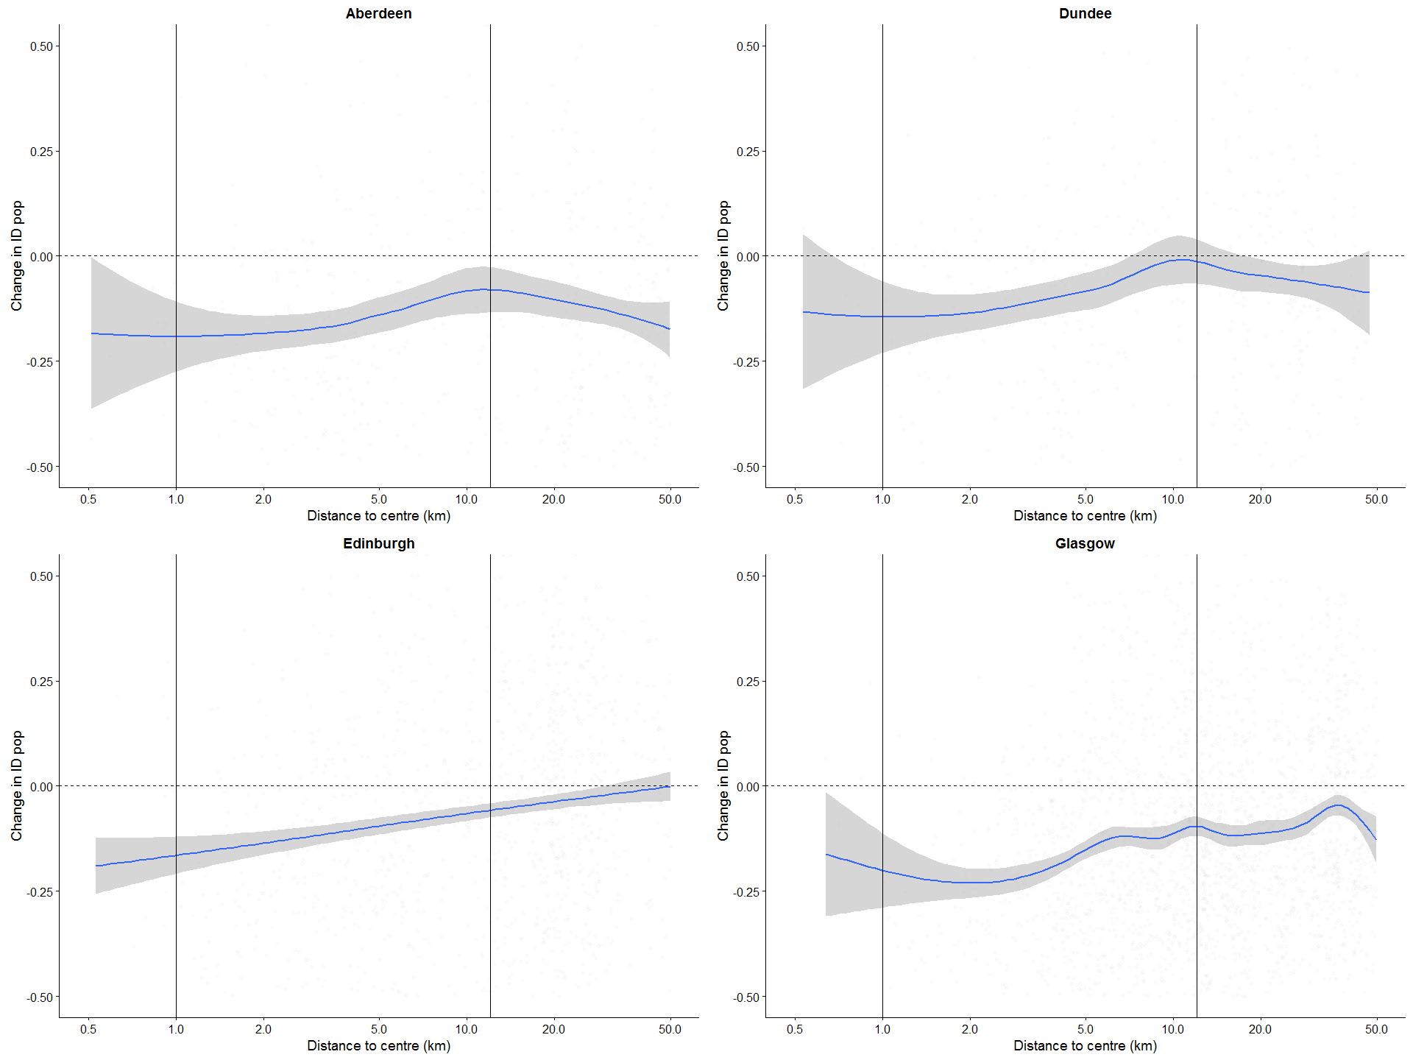
Change in income deprived population by distance from centre
Greatest falls near city centre: ‘Gentrification’
Largest global fall in Glasgow
‘Kinks’ in Aberdeen & Dundee: city region/ suburb/rural zones?

Slide 27
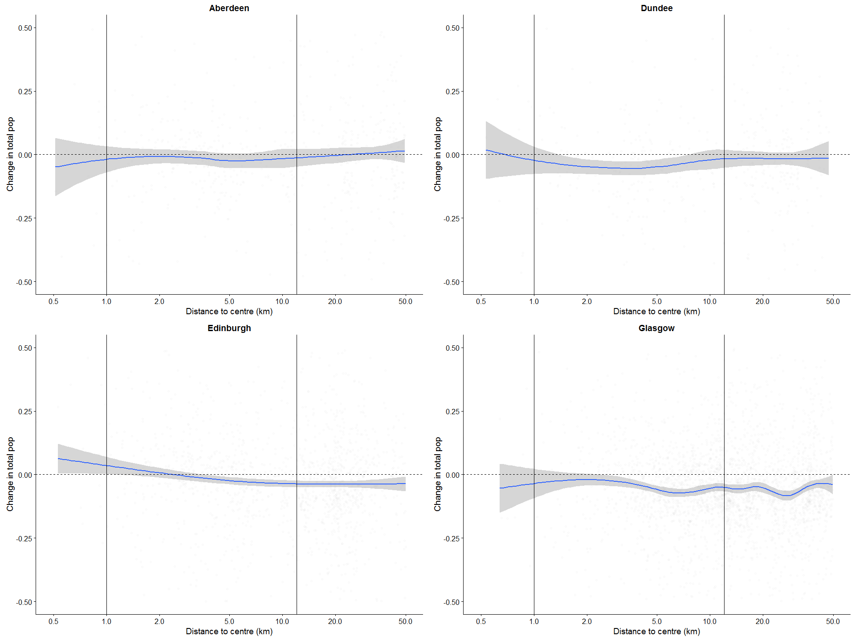
Change in total populations by distance
Glasgow:
Replacement of poor w/ rich near centre
Depopulation/dedensification further from centre
Edinburgh:
Shift from periphery to centre – disproportionately affluent
More limited change elsewhere

Slide 28
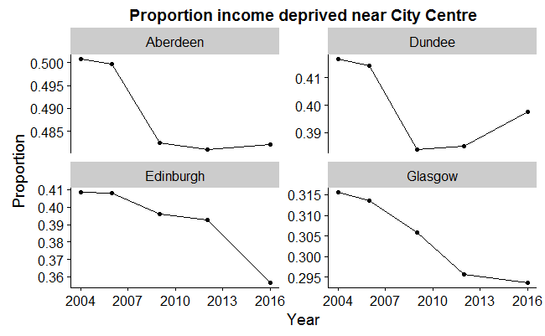
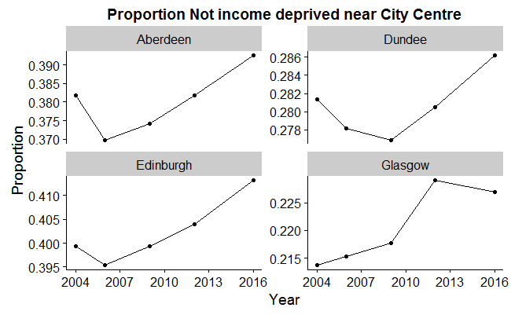
Put more simply…

Slide 29
Discussion
Reasonable evidence of ‘back-to-the-city’ movements in Scottish cities
Clear variations between places
Edinburgh and the rest
Smaller & more clearly defined city limits for Dundee & Aberdeen?
Change in Glasgow matters more for change in Scotland due to its size
Replacement of ID with non-ID populations, rather than strong population growth
Changes are generally ‘statistically significant’
Some invariance of ‘bottom line’ to particular measures used
Using SIMD suggests 2009-2012 important transition point
Segregation and decentralisation changes are related but perhaps distinct
Change in D preceded change in RCI

Slide 30
Discussion
Maps reveal more about spatial patterns of change
Influence of big changes in small specialist areas (e.g. zones w/ very high social housing) to global changes
Also suggest something about effective city limits (e.g. Dundee; rural Aberdeen)
English as main economic migrant group:
selected to be unlikely to be ID
Englishification of Edinburgh city (especially during the Festival!)
Have the ID been replaced with non-ID (selective migration), or turned into non-ID?
Labour market improvement
Affordable housing deterioration; change in housing stock (e.g. Glasgow East)

Slide 31
Further work
Always…
From technical report to paper
Link to extant literature
Further sensitivity analyses
Refinements to presentation of results etc

